Slide 1
Application of graph traversal for marathon training optimization
Saleh Alkhalifa
Gabriel Cuchacovich
Nile Naim

Slide 2

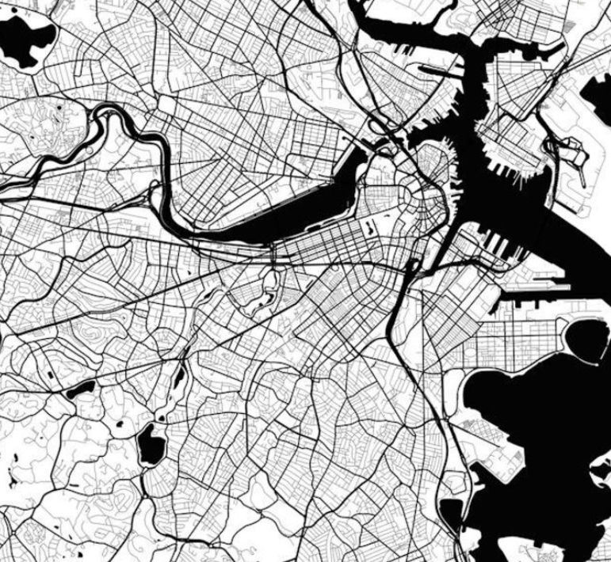
Problem Statement
There are many technologies and devices catered for cars allowing users to find optimal driving paths from a source to a destination
There does not exist many solutions that offer similar capabilities for runners, especially those in dense smaller cities such as Boston
Given the many algorithms we have covered this semester, we wanted to investigate the use of several for runners in the Boston area.

Slide 3

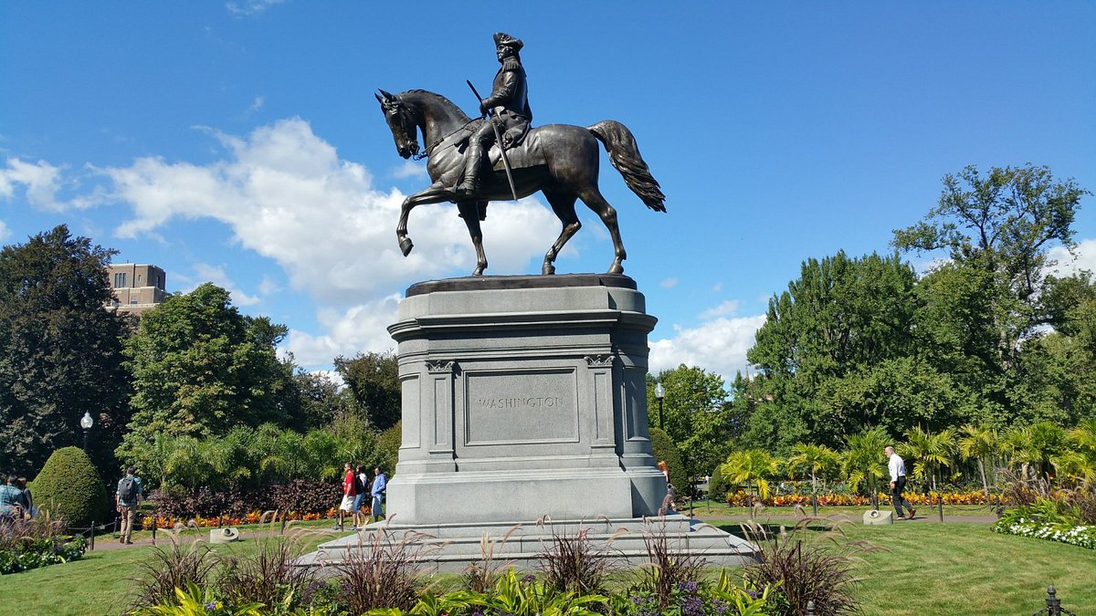
Methods
We hope to investigate three different use cases within our proof of concept (POC) application.
Methods:
Method 1:
Application of Dynamic Programming for Longest Limited Path Detection
Use Case: Users may want to find the longest paths in a small neighborhood to maximize distance, but limited to a specified amount.
Method 2:
Application of Shortest Path via Dijkstra’s Algorithm
Use Case: Users may want to visit certain sites in Boston to stay motivated on their run
Method 3:
Application
Use Case:

Slide 4
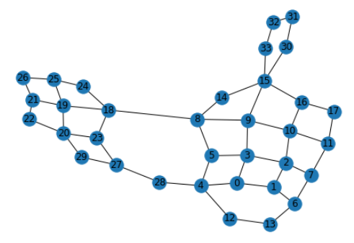
Graph Preparation
To demonstrate the feasibility of these algorithms, we prepared a proof of concept (POC) using a small neighborhood in Boston near Northeastern’s campus
We used the networkx library to draw and save the graph using the Python programming language
We drew our map using Google Earth, and traced the distance, measured in meters, using networkx
We then converted the dataset we obtained to an adjacency list (no weights), and an edge list (with weights).
Figure: A graphical representation of a small neighborhood in Boston near Northeastern’s campus.

Slide 5
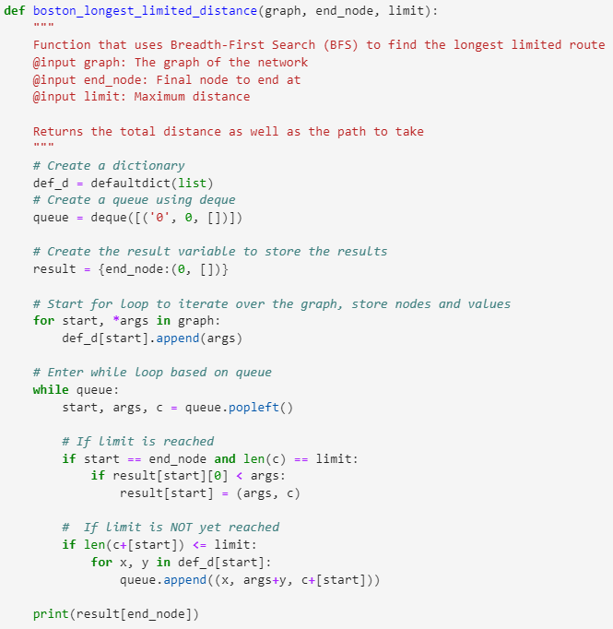
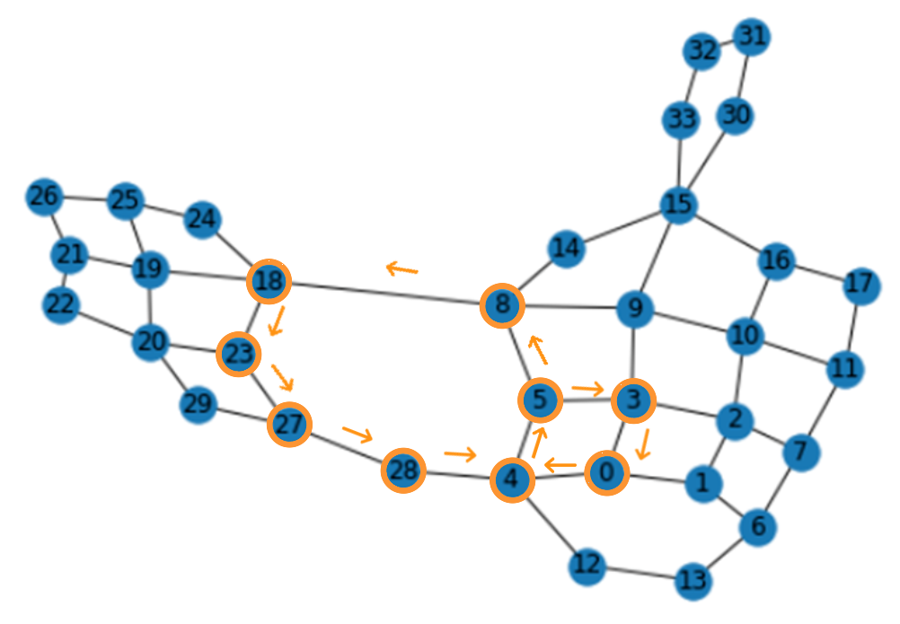
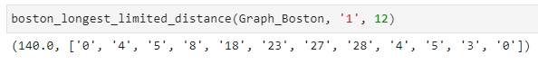
Method 1: Longest limited Path
Algorithm:
Instantiate a dictionary, queue, and result variables to manage the data (nodes and weights) and final values
Iterate over the graph to prepare the starting nodes and targets in a dictionary
Iterate over the queue to apply BFS
If the user specified limit is reached, end the program
If the limit is not reached, continue BFS algorithm
Original Map
Determined Path

Slide 6

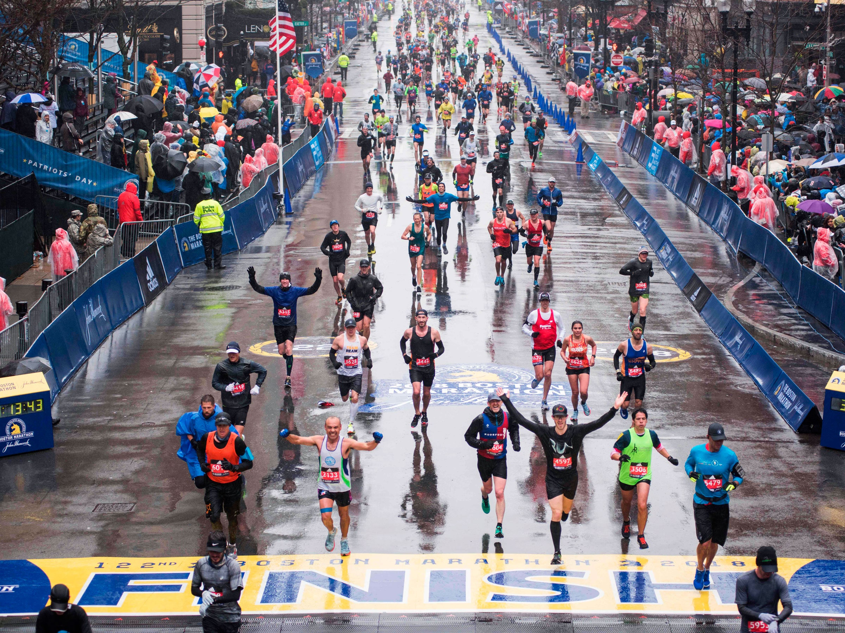
Method 1: Longest Limited Path Summary
The longest path problem is a well known area of research that involves finding a path of maximum length.
The longest path problem is NP-Hard, as opposed to the shortest path which can be solved in polynomial time.
Given that we want to allow the user to limit the length of the path, we used Breadth-First Search to allow this functionality.
The time complexity of BFS is O(|V| + |E|) in which V is a set of the nodes, and E is a set of the edges
Given our use case of focusing on smaller neighborhoods in the Boston area, within running distance, we do not anticipate users reaching higher values of nodes and edges.
In summary, we managed to develop an algorithm in Python based on BFS that allows the user to find a long path in a given neighborhood which can be limited based on the users preferences.

Slide 7
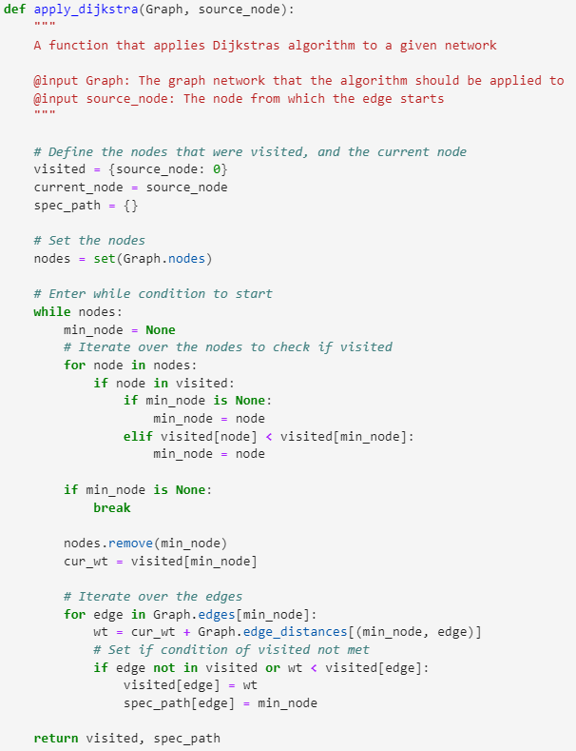
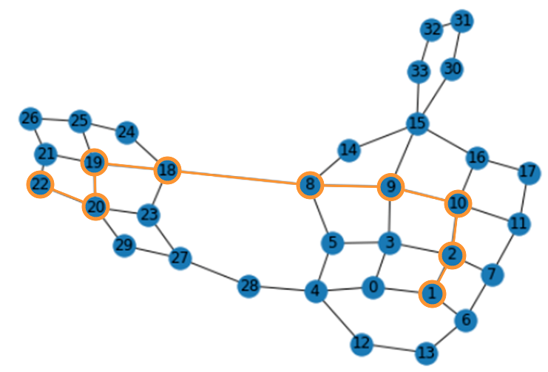
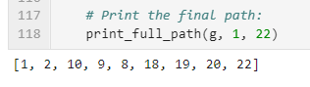
Method II: Dijkstra’s Shortest Path
Algorithm:
Mark the nodes unvisited and instantiate a new set for them
Set the initial distance from the source to the target as ‘infinite’
Calculate distances of neighbor nodes of the active node, sum distance with weights of distances from Graph
If calculated distance is smaller, update the distance and set the current node
Repeat until no nodes left and all accounted for
Original Map
Determined Path

Slide 8
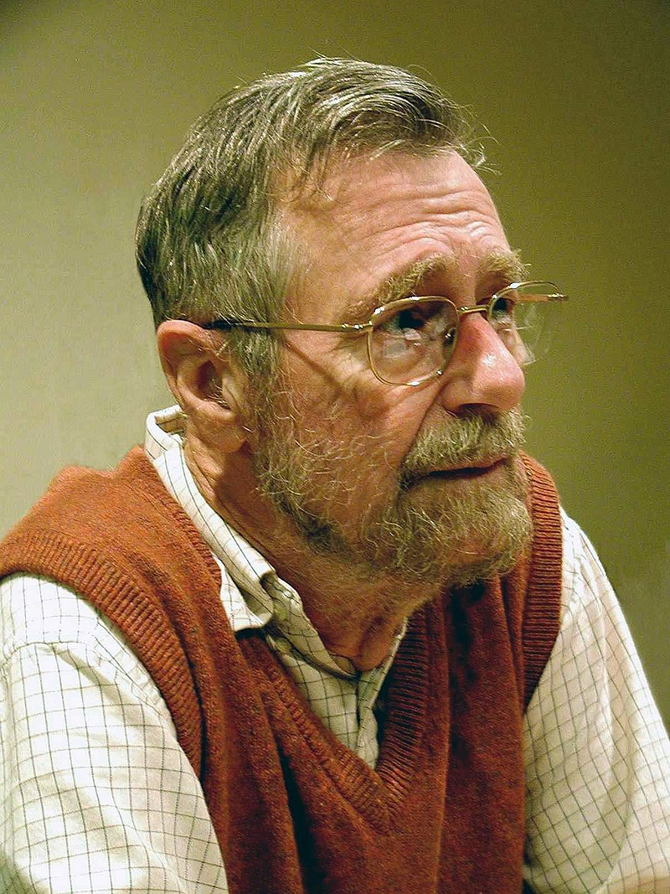
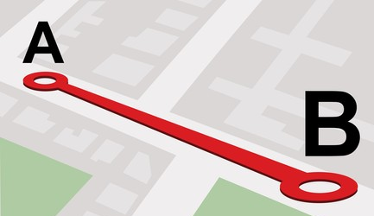
Method II: Dijkstra’s Shortest Path Summary
The shortest path problem has the objective of finding a path between two nodes in which the sum of weights between them is minimized relative to other paths
There are a number of different algorithms that have been developed to solve this problem: (1) Bellman-Ford, (2) Floyd-Warshall, and (3) Dijkstra’s.
For the purposes of this POC, we focused on Dijkstra’s algorithm.
In our previous method, we supported our long distance runners by finding the longest path. In this method, we support our short distance runners, or perhaps our lazy runners (such as myself), by finding the shortest distance between two nodes
In this algorithm, the time complexity as the result of each edge is O(|E|), and the complexity of each vertex is O(|V|).
Given our implementation, we reached a time complexity of O(|E| + |V|).
A future improvement could be to use a priority queue, in order to reach a time complexity of O(|E| + |V| log |V|)

Slide 9
Method III

Slide 10
Method III

Slide 11
Summary

